Slide 1

Mobile Application Development

Slide 2

GROUP MEMBERS
Chathura Madushan
Pasindu Dananjaya
Kaveesha Prasanna
Thiwanshika Isuruni

Slide 3
Content
Introduction
Problem Statement
Architecture
Functions
Project Plan
Work break down structure
Conculation
Any Question

Slide 4

INTRODUCTION
The system we have developed is designed to provide users with comprehensive information about various courses, course centers, and easy registration options.
It aims to streamline the process of accessing course details and simplifying the registration process for interested individuals.
Additionally, the system offers a summary of all available courses, allowing users to get a quick overview of the offerings.

Slide 5
  Problem Statement
There is a lack of a consolidated overview of all available courses.
Existing methods are often inefficient.
Time-consuming.
lack user-friendliness.

Slide 6

ARCHITECTURE
For the VTA, we created an Android mobile application, using Firebase as the database.
The information entered into the registration form by the student is transmitted securely via the internet to the firebase where it is kept.
While the admin panel interface enables authorized personnel to access and view the information of registered students, the course interfaces inside the app allow users to select a course and read full information.
The register form and the Firebase database are easily coupled, resulting in effective data management and retrieval.

Slide 7



VTA Background
Details
Course Details
Center Details
Registration Form
Admin Panel
Information store database

Slide 8

User can click the start button then user can see menu interface.
Users of the interface: - All registered and unregistered/back end and front end users.
HOME INTERFACE

Slide 9
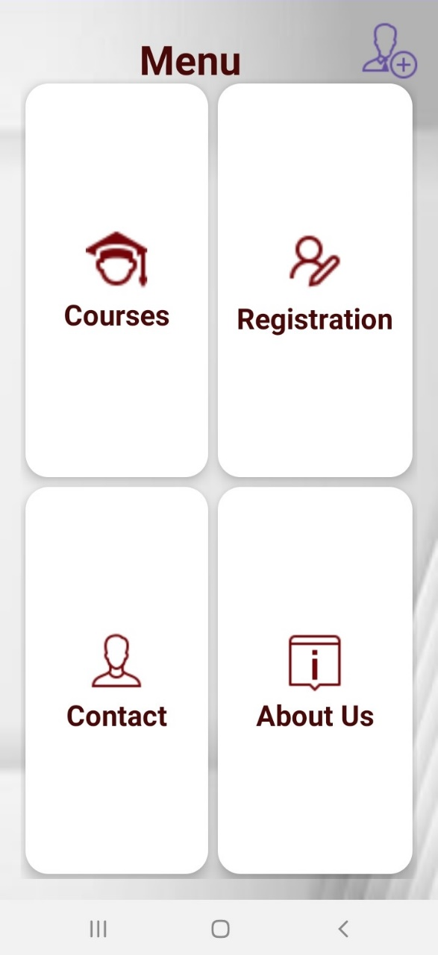
MENU INTERFACE
User can see the Menu interface four categories
Courses
Registration
Contact
About Us
Users of the interface: - All registered and unregistered/back end and front end users.

Slide 10
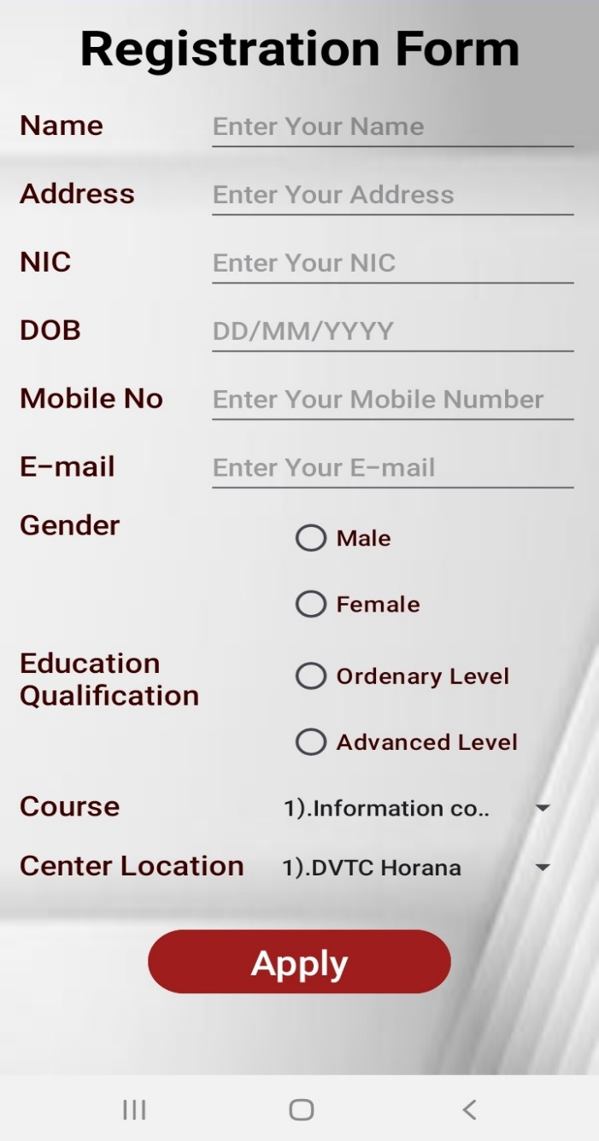
REGISTRATION FORM INTERFACE
Fill the details and after user can click the apply button user can register the course.
Users of the interface: - All registered and unregistered/back end and front end users.

Slide 11
FUNCTIONS
User Registration
Course Details
Course Center Information
Course Catalog Overview
Registration Process

Slide 12
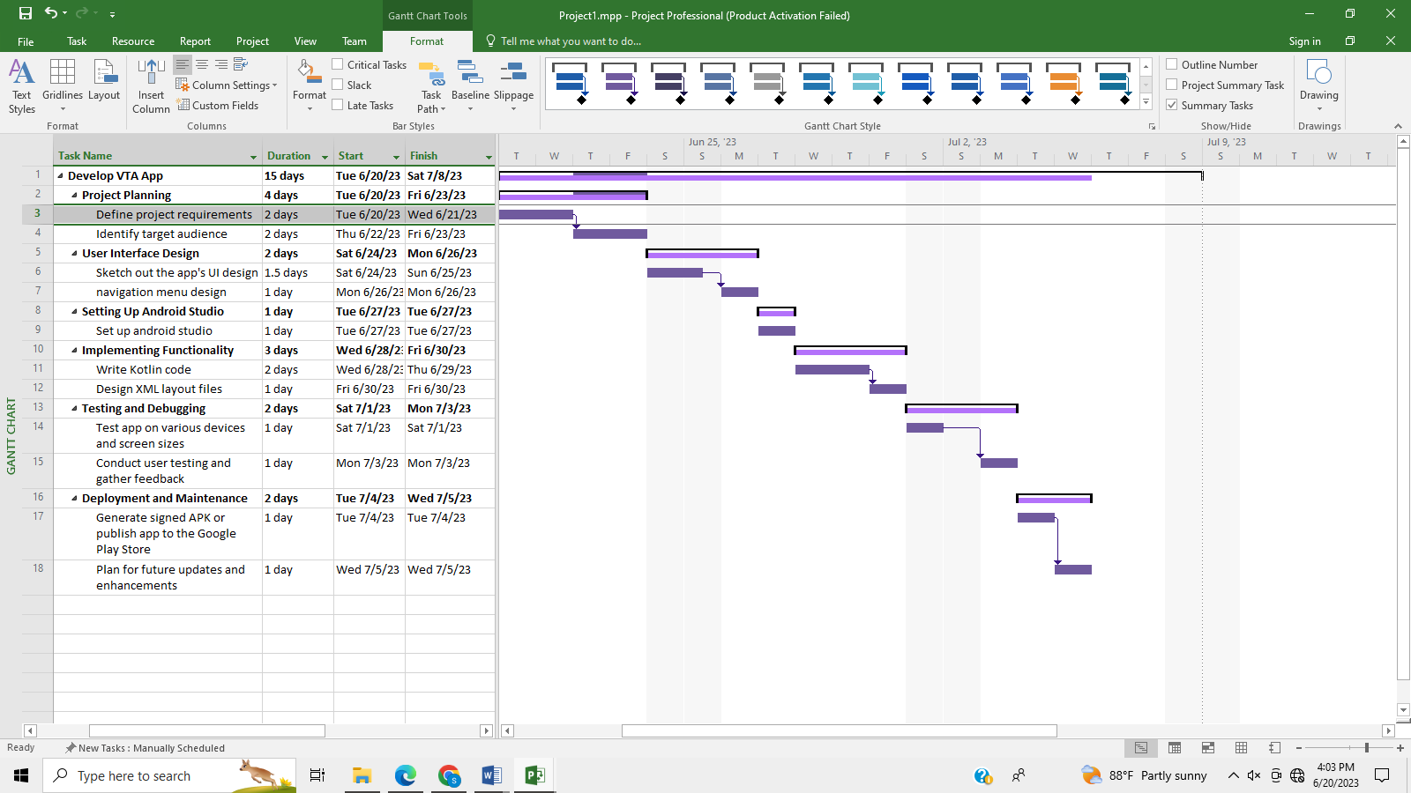
PROGECT PLAN

Slide 13
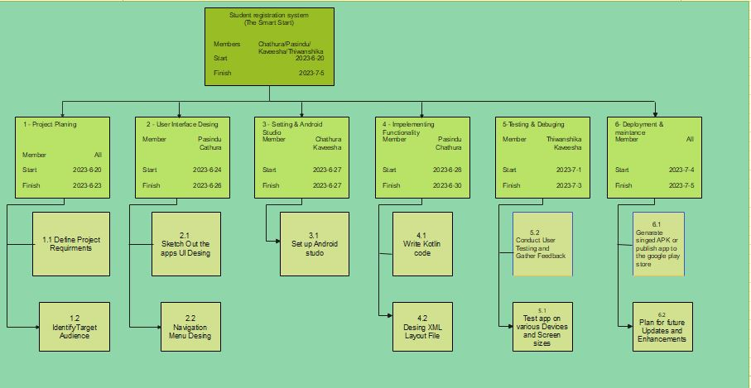
WORK BREAK DOWN STRUCTURE

Slide 14

CONCULATION
In Conclusion, the app we developed for student submission and administrative management, utilizing a firebase database, offers a streamlined and efficient solution for handling student data.
By leveraging firebase’s capabilities, such as data storage and retrieval, our app provides an effective platform for students to submit their information and allows administrators to conveniently view and manage the submitted data.
This app simplifies the process of the data submission and management, enhancing efficiency and organization in the educational setting.

Slide 15
FUTURE DEVELOPMENT
Modify the admin panel
admin can delete and modify user details.
he can also add , delete and modify course details.
super admin can add another admins.
Add user profile
user can modify and delete his/her details if there was a error.

Slide 16
Any Question ?

Slide 17
THANK YOU

